Slide 1
Introduction to Machine Learning through Text Classification using Python
Nate Mahalingam
Crosby mba,2017

Slide 2
Structure
Who am I?
What is Machine Learning?
Deriving Logistic Regression and the Gradient Descent algorithm
Overview of Python
Running the actual code

Slide 3
Who am I?
MBA student focusing in Marketing Analytics
Born and raised in South India
Bachelor’s and Master’s in Chemical Engineering from the UK
Taught myself Python because it’s awesome!
Around 3 years of experience with Python
Major projects
Delivering the AP news on the Amazon Echo
Text classification for Sears
Notes:
Maybe add the video of the echo demonstration?

Slide 4
What is Machine Learning?
“Machine learning is the science of getting computers to act without being explicitly programmed”
What can we do with it?
Predict future sales based on current data
Predict whether a tumour is malignant or not
Predict whether an image contains a face or not
Teach a computer to play a game
And many more…

Slide 5
Types of Machine Learning
Supervised
Given a set of input variables and corresponding output variables, train on one half of the set and predict the other half and any other similar data’s output
Further classified into Regression and Classification problems
Examples: Linear Regression, Logistic Regression, Naïve Bayes, Support Vector Machine, Perceptron, Random Forest, etc.
Unsupervised
Given a set of inputs with NO outputs, find clusters and/or associations between the inputs
Further classified into Clustering and Association problems
Examples: K-means, Artificial Neural Networks, Principal Component Analysis, Singular Value Decomposition, etc

Slide 6

Some Nomenclature
$$X^{i}=Input Vector \left(Features\right)$$
$$y^{i}=Output Vector \left(Target\right)$$
$$\left({X^{i},y}^{i}\right)=Training Example$$
$$\left\{\left({X^{i},y}^{i}\right), i=1,2,…,m\right\}=Training Set$$
$$Hypothesis:A function h\left(x\right) that maps from input X to output y$$
Notes:
Give examples using the text document term matrix

Slide 7
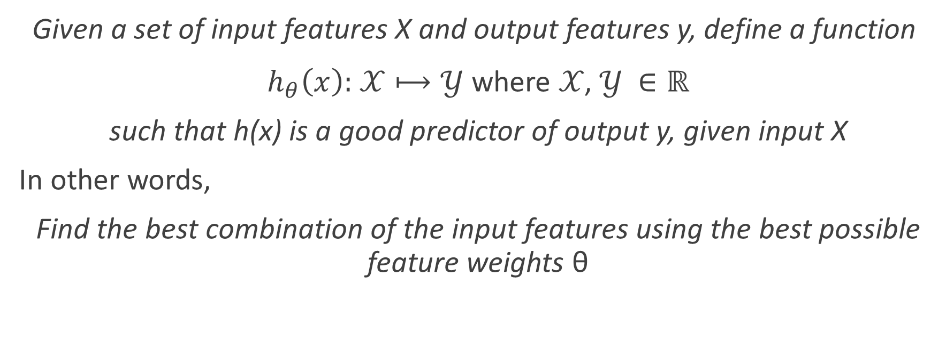
Our Goal
Given a set of input features X and output features y, define a function
$h_{θ}\left(x\right)\text{: }\text{𝒳}⟼\text{𝒴}$ where $\text{𝒳}\text{, }\text{𝒴} ∈\text{ℝ}$
such that h(x) is a good predictor of output y, given input X
In other words,
Find the best combination of the input features using the best possible feature weights θ
Notes:
Write out the 1/(1+exp-(b0+b1x1+b2x2+…+bnxn))
Explain how it can be represented as a vector

Slide 8

Training Set
Learning Algorithm
$$h$$
X
y

Slide 9
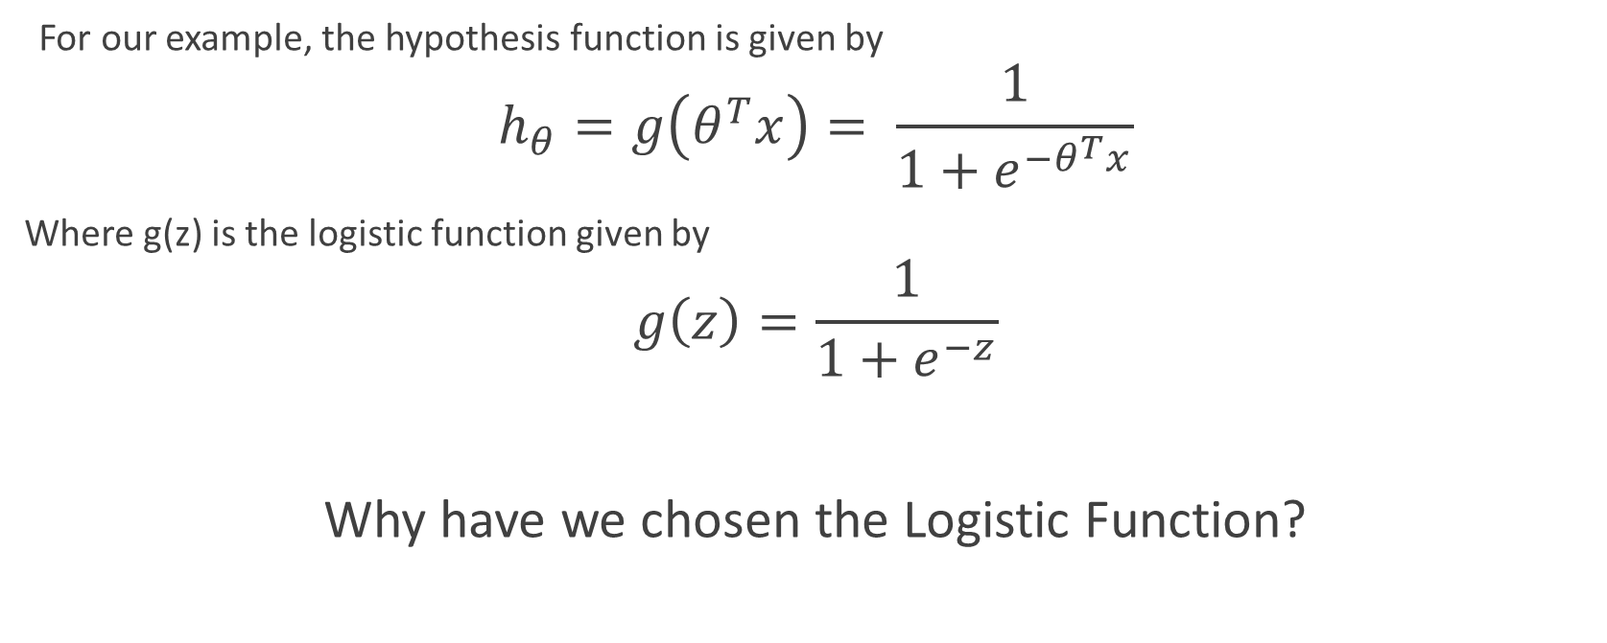
Logistic Regression
For our example, the hypothesis function is given by
$$h_{θ}=g\left(θ^{T}x\right)= \frac{1}{1+e^{−θ^{T}x}}$$
Where g(z) is the logistic function given by
$$g\left(z\right)=\frac{1}{1+e^{−z}}$$
Why have we chosen the Logistic Function?
Notes:
Show the logistic function sigmoid shape now
Lies between 0 and 1 which is convenient for us

Slide 10
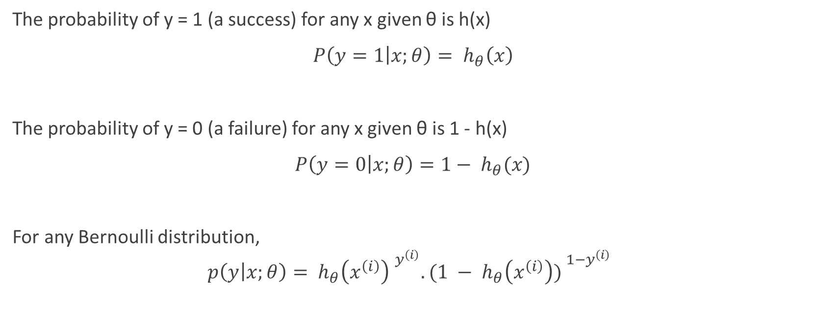
Deriving the Stochastic Gradient Ascent algorithm 1
The probability of y = 1 (a success) for any x given θ is h(x)
$P\left(y=1 | x;θ\right)= h_{θ}\left(x\right)$
The probability of y = 0 (a failure) for any x given θ is 1 - h(x)
$P\left(y=0 | x;θ\right)=1− h_{θ}(x)$
For any Bernoulli distribution,
$$p\left(y | x;θ\right)= {h_{θ}\left(x^{\left(i\right)}\right) }^{y^{\left(i\right)}}.({{1 − h}_{θ}\left(x^{\left(i\right)}\right)) }^{{1−y}^{\left(i\right)}}$$
Notes:
The probability of y =1 for any x given theta is h(x); The probability of y =0 for any x given theta is 1-h(x)
The notation “p(y(i)|x(i); θ)” indicates that this is the distribution of y(i) given x(i) and parameterized by θ. p(y|x; θ), the conditional distribution of y given x
Consider logistic regression, where the probability p(y = 1|x; θ) is modeled by hθ(x) = g(θT x). We would then predict “1” on an input x if and only if hθ(x) ≥ 0.5, or equivalently, if and only if θT x ≥ 0. Consider a positive training example (y = 1). The larger θT x is, the larger also is hθ(x) = p(y = 1|x; w, b), and thus also the higher our degree of “confidence” that the label is 1. Thus, informally we can think of our prediction as being a very confident one that y = 1 if θT x ≫ 0. Similarly, we think of logistic regression as making a very confident prediction of y = 0, if θT x ≪ 0. Given a training set, again informally it seems that we’d have found a good fit to the training data if we can find θ so that θT x(i) ≫ 0 whenever y(i) = 1, and θT x(i) ≪ 0 whenever y(i) = 0, since this would reflect a very confident (and correct) set of classifications for all the training examples. This seems to be a nice goal to aim for, and we’ll soon formalize this idea using the notion of functional margins

Slide 11

Deriving the Stochastic Gradient Ascent algorithm 2
Define the Likelihood function L(θ)
$$ℒ\left(θ\right)= \prod_{i=m}^{m}{{h_{θ}\left(x^{\left(i\right)}\right) }^{y^{\left(i\right)}}.({{1 − h}_{θ}\left(x^{\left(i\right)}\right)) }^{{1−y}^{\left(i\right)}}}$$
What does this represent?
Notes:
Given X (the design matrix, which contains all the x(i)’s) and θ, what is the distribution of the y(i)’s? The probability of the data is given by p(~y|X; θ). This quantity is typically viewed a function of ~y (and perhaps X), for a fixed value of θ. When we wish to explicitly view this as a function of θ, we will instead call it the likelihood function
Likelihood is used after data are available to describe a function of a parameter (or parameter vector) for a given outcome.

Slide 12
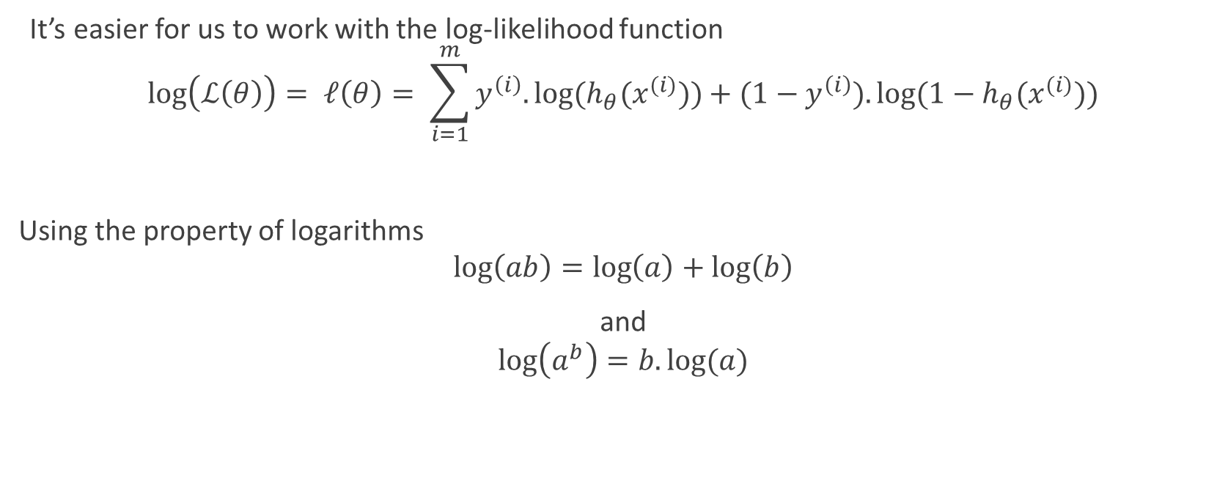
Deriving the Stochastic Gradient Ascent algorithm 3
It’s easier for us to work with the log-likelihood function
$$\log\left(ℒ\left(θ\right)\right)= ℓ\left(θ\right)= \sum_{i=1}^{m}{y^{\left(i\right)}.log⁡(h_{θ}(x^{(i)}))}+{(1−y}^{\left(i\right)}).log⁡({1−h}_{θ}(x^{(i)}))$$
Using the property of logarithms
$$\log\left(ab\right)=\log\left(a\right)+\log\left(b\right)$$
and
$$\log\left(a^{b}\right)=b.log⁡(a)$$

Slide 13

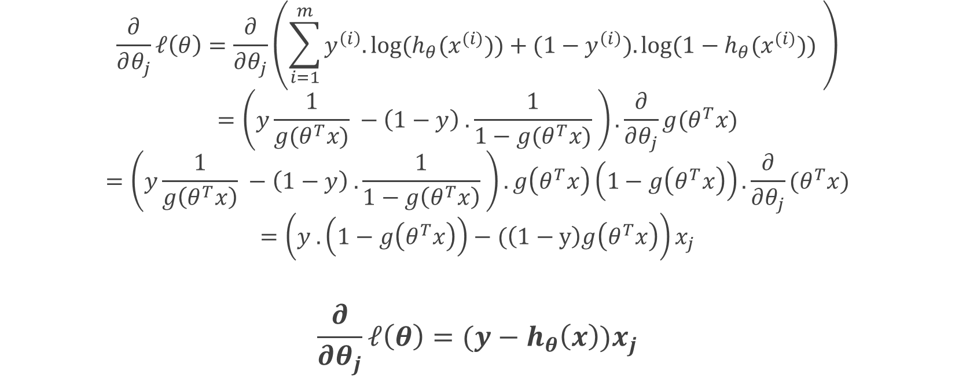
Deriving the Stochastic Gradient Ascent algorithm 4
$$\frac{∂}{∂θ_{j}}ℓ\left(θ\right)=\frac{∂}{∂θ_{j}}\left(\sum_{i=1}^{m}{y^{\left(i\right)}.log⁡(h_{θ}(x^{(i)}))}+{(1−y}^{\left(i\right)}).log⁡({1−h}_{θ}(x^{(i)})) \right)$$
$$=\left(y\frac{1}{g(θ^{T}x)} −\left(1−y\right) . \frac{1}{1−g(θ^{T}x)} \right).\frac{∂}{∂θ_{j}}g(θ^{T}x)$$
$$=\left(y\frac{1}{g\left(θ^{T}x\right)} −\left(1−y\right) . \frac{1}{1−g\left(θ^{T}x\right)} \right).g\left(θ^{T}x\right)\left(1−g\left(θ^{T}x\right)\right).\frac{∂}{∂θ_{j}}(θ^{T}x)$$
$$=\left(y .\left(1−g\left(θ^{T}x\right)\right)−(\left(1−y\right)g\left(θ^{T}x\right)\right)x_{j}$$
$$\frac{∂}{∂θ_{j}}ℓ\left(θ\right)=(y−h_{θ}\left(x\right))x_{j}$$
$$g^{′}\left(z\right)=g\left(z\right).(1−g\left(z\right))$$

Slide 14

The Final Stochastic Gradient Ascent Rule
Loop {
for i = 1 to m {
$θ_{j} ≔θ_{j}+ α\left(y^{\left(i\right)}−h_{θ}\left(x^{\left(i\right)}\right)\right)x_{j}^{\left(i\right)} (for every j)$
}
}

Slide 15
A QUICK DEMONSTRATION OF THIS RULE
Notes:
Show the gradient descent steps in python

Slide 16
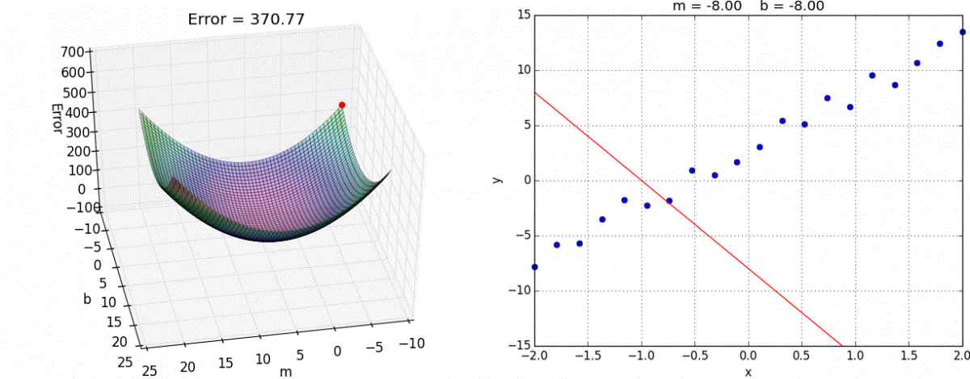
Notes:
This should animate

Slide 17
Used for binomial classification
By
Maximizing the likelihood of the output
Through
Stochastic Gradient Ascent Rule
Logistic Regression
Predict
Determine the best combination of features
Output through trained parameters for the features
Determine the parameters of the features

Slide 18
Python
Created in 1991 by Guido van Rossum
Emphasizes readability and simplicity over complexity
“Simple is better than complex.”
Software that use Python
Dropbox
MySQL Workbench
BitTorrent
And many more
More emphasis on scripting than programming
Syntactic sugar

Slide 19
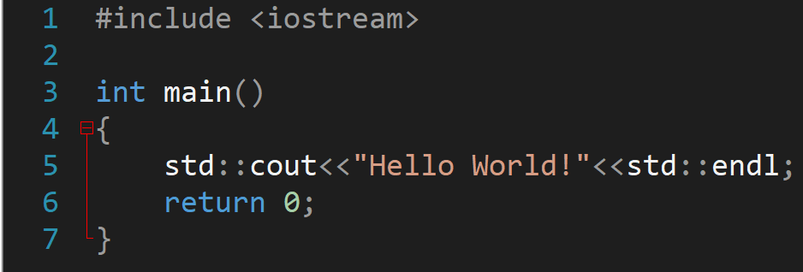
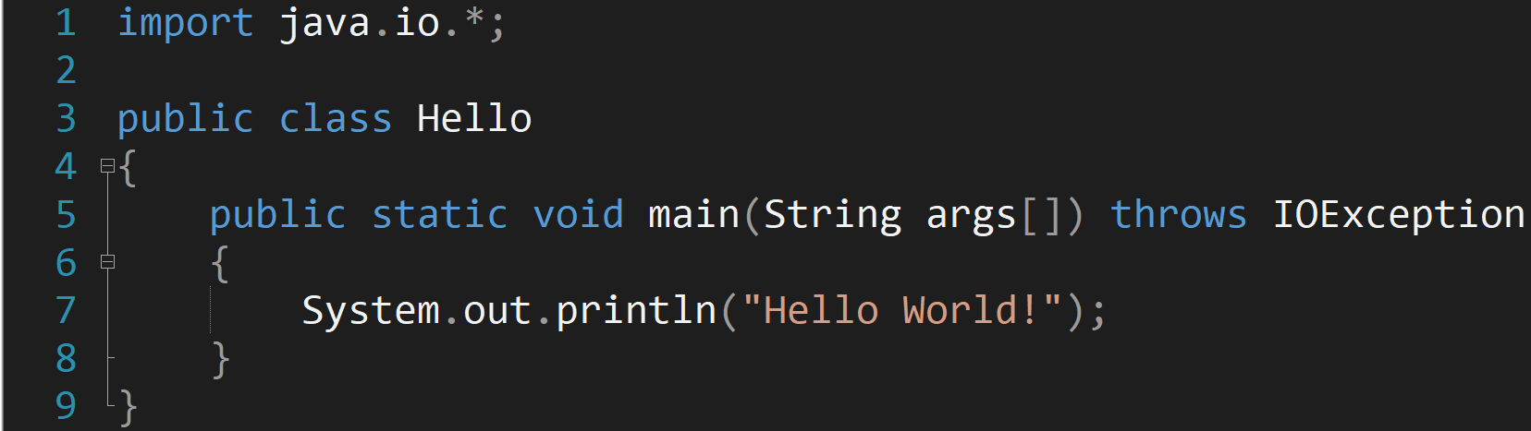

Slide 20






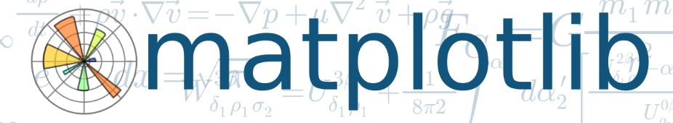
Packages needed
NLTK

Slide 21
Time to run the actual code!
Notes:
Switch to jupyter notebook

Slide 22
Questions

